Slide 1
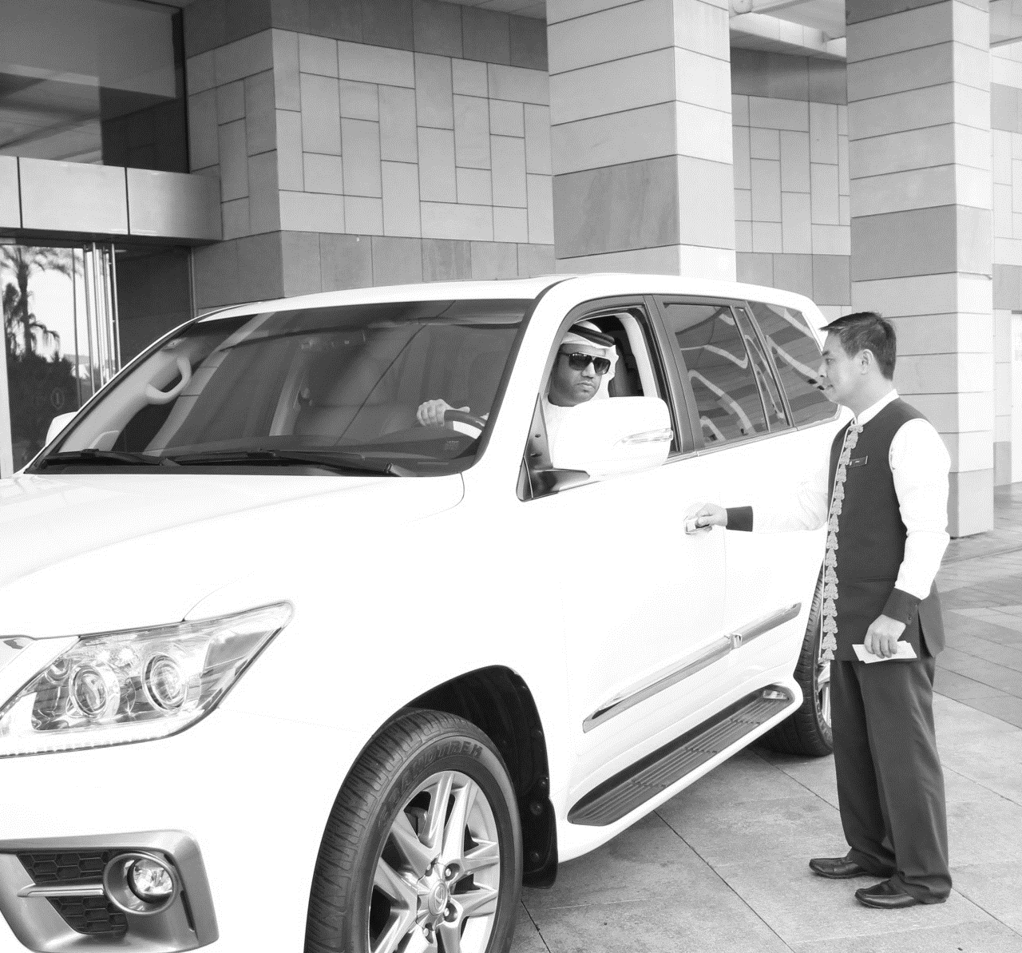
OSCAR
MOBILE APPLICATION
Presented By DEEPTHI KRISHNA BUSINESS HEAD VERBANET TECHNOLOGIES LLC

Slide 2
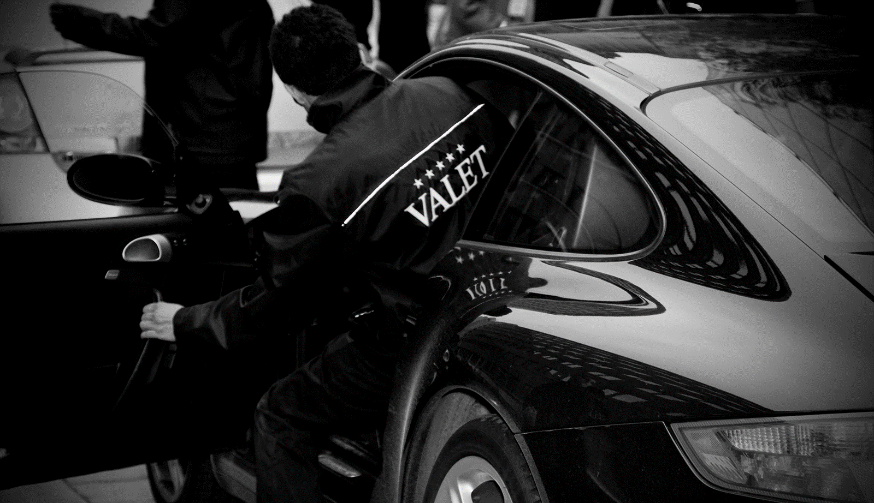

REQUIREMENT
and OBJECTIVE
1
Oscar Web Application
DEVELOP A MOBILE APPLICATION

Slide 3

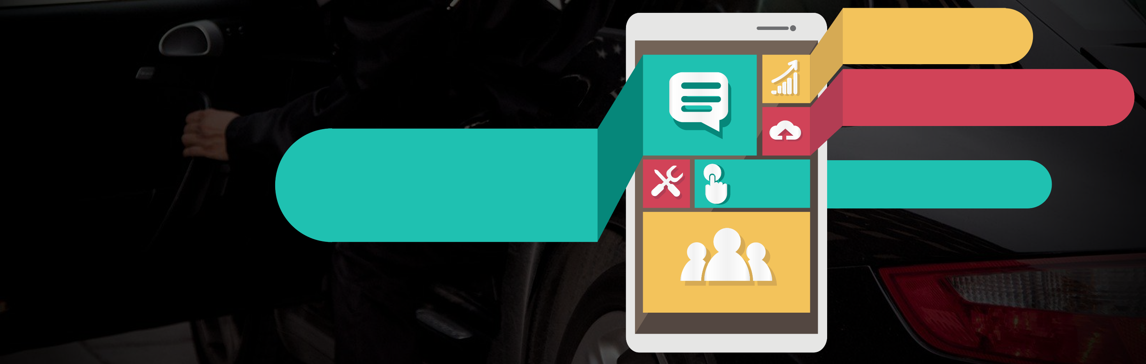


2
Oscar Mobile Application
GUESTS
OBJECTIVE and PLATFORM
CVA
Mobile Application
Development
RESTAURANTS

Slide 4

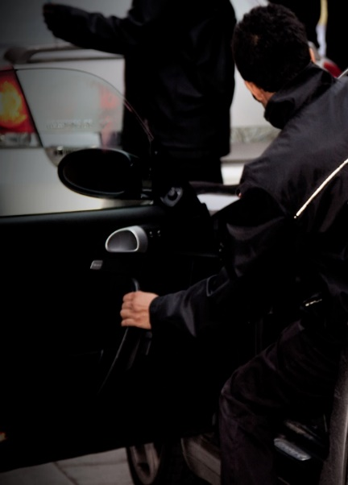






WEB SERVER
OSCAR VALET SYSTEM
DATABASE SERVER
ARCHITECTURAL OVERVIEW
CVA
GUEST MOBILE APPLICATION
RESTAURANT
APPLICATION

Slide 5
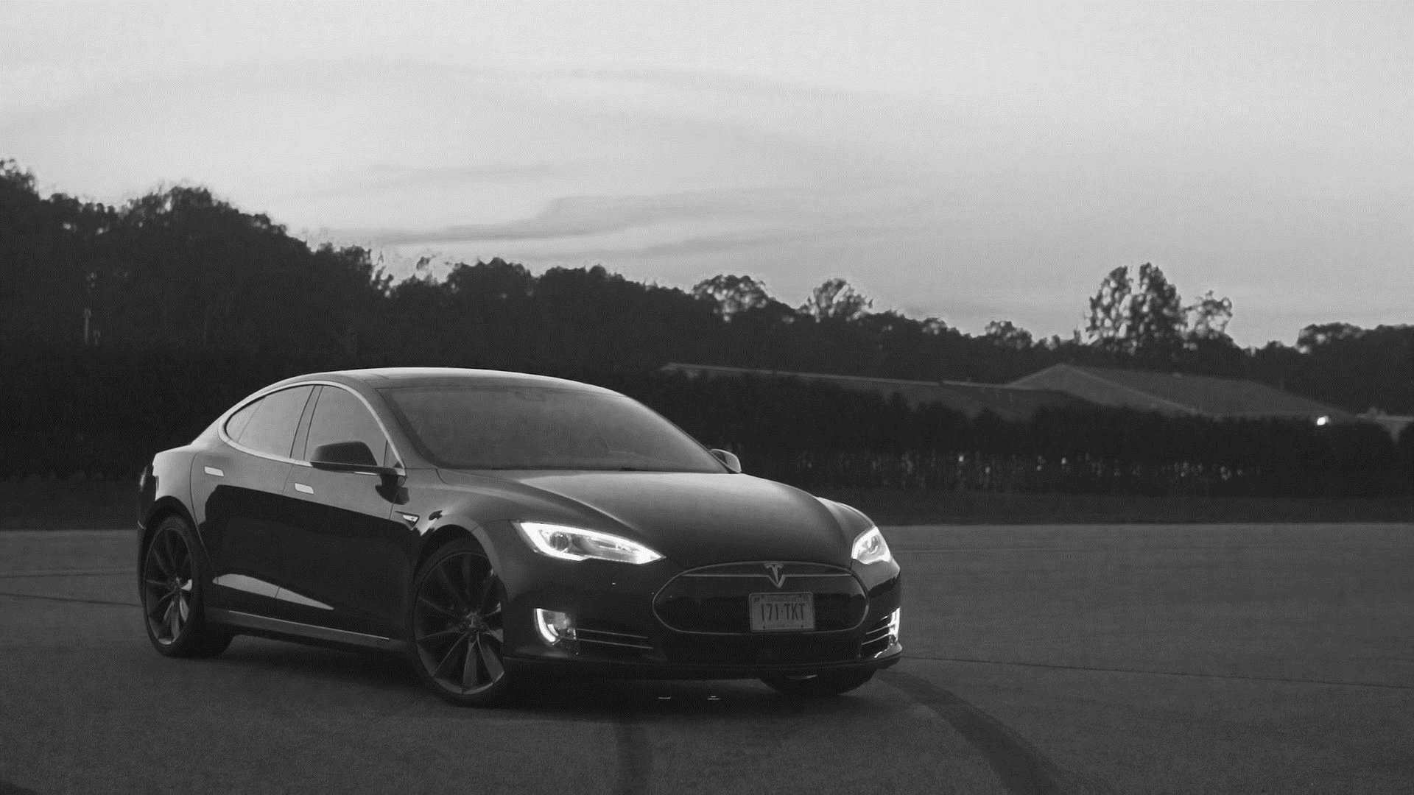


CHECK IN
CHECK OUT
Yes
Register with name, mobile number & vehicle details
Generate the QR Code via app
CVA Scan the QR Code
Handover the vehicle
Restaurants validate ticket (if applicable)
Send intimation to the valet station
App Downloaded?
Pay the fee if applicable
Collect vehicle from CVA
HIGHLEVEL OVERVIEW:
GUESTS
Pay fee if applicable
No
Get the parking ticket from CVA
Handover the vehicle
Restaurants validate ticket manually (if applicable)
Submission of the tickets to the CVA

Slide 6

CHECK IN
Get the vehicle from guest
Scan the QR Code provided by the guests
Take images in case of any damages in the vehicle
Find the free parking lot using the app
Park the vehicle
Scan the QR Code available in the parking lot
CHECK OUT
CVA
Yes
Do not collect fee
HIGHLEVEL OVERVIEW:
CVA
Validation from restaurant
Receive an intimation of vehicle requested for retrivel
Find the vehicle parking location using application
Make the vehicle ready for handover
Hand Over the Vehicle
Need to collect fee
No
Vehicle released from valet possession
Rescan the QR Code
Supervisor

Slide 7

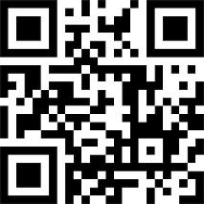


HIGHLEVEL OVERVIEW:
RESTAURANTS
Validation updates the central system & message send to supervisor
1
2
3
Restaurants
(Hotels, Malls)
Validate the QR Code

Slide 8
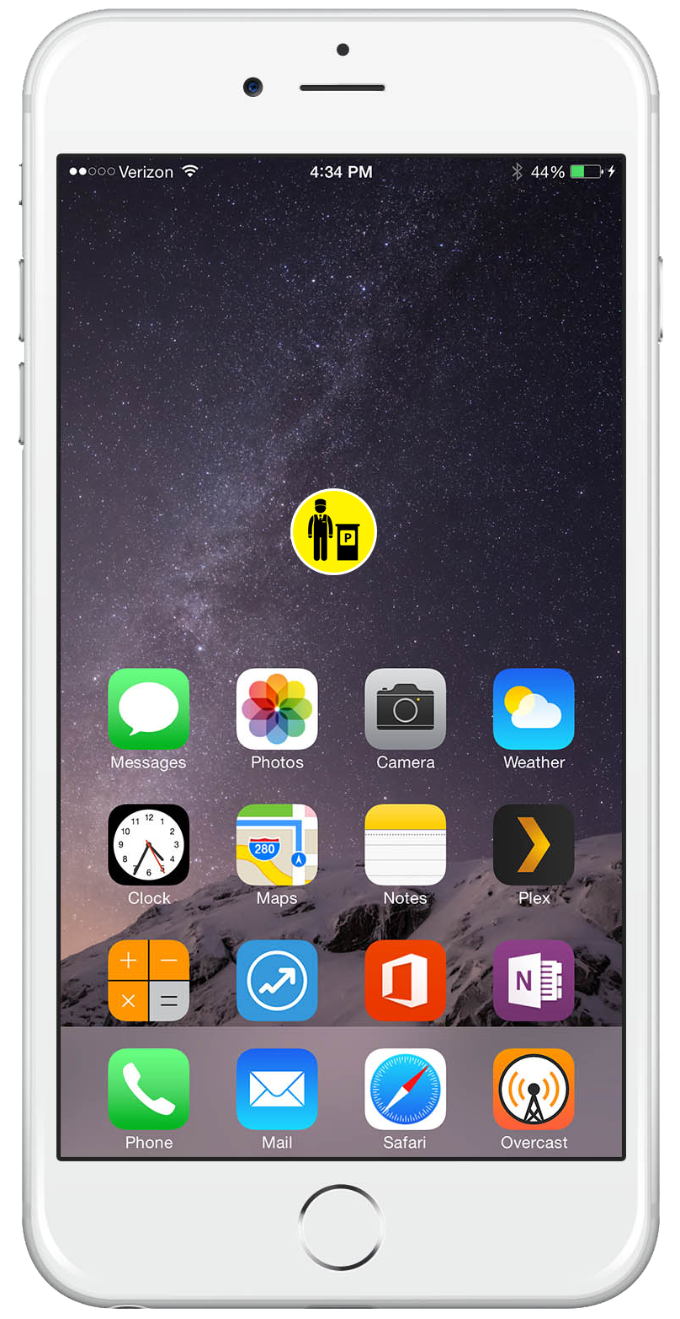
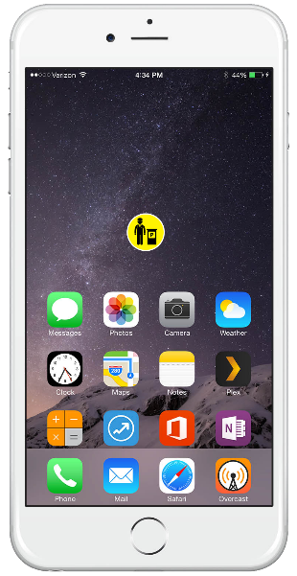


mValet PARKING
Guests
INFO
CARS
QUICK REQUEST
RATE US
GUESTS INITIAL SCREEN
Download the App
FEEDBACK
CONTACT US

Slide 9

mValet PARKING
mValet PARKING
INFO
CARS
About the Application
A mobile app is a computer program designed to run on a mobile device such as a phone/tablet or watch. Mobile applications often stand in contrast to desktop applications that run on desktop computers, and with web applications which run in mobile web browsers rather than directly on the mobile device.
QUICK REQUEST
RATE US
INFO SCREEN
FEEDBACK
CONTACT US

Slide 10
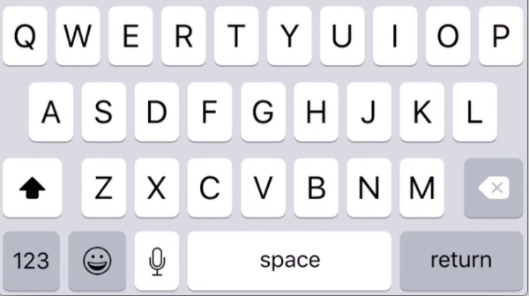
mValet PARKING
mValet PARKING
mValet PARKING
Reg. No.
Car Model
INFO
CARS
Cars
Car Color
Emirates
Code
QUICK REQUEST
RATE US
ADD NEW
EXISTING
Plate No.
CARS: ADD NEW
Previous
Save
FEEDBACK
CONTACT US
Previous

Slide 11

mValet PARKING
mValet PARKING
mValet PARKING
Cars
Vehicle List
Vehicle
Audi R8 R12346
ADD NEW
EXISTING
Bugati Veyron Y89009
EDIT
DELETE
CARS: EXISTING
Jaguar F-Type Y89009
Mercedes SLS AMG Y89009
Maruti Wagor-R Y89009
Previous
Previous
Previous
Next
Previous

Slide 12
mValet PARKING
mValet PARKING
Reg. No.
Car Model
Vehicle
Car Color
Emirates
Code
EDIT
DELETE
Plate No.
CARS: EDIT DETAILS
Previous
Save
Previous

Slide 13
mValet PARKING
mValet PARKING
Vehicle
Vehicle
EDIT
DELETE
DELETE VEHICLE
CANCEL
CARS: DELETE DETAILS
Previous
Previous

Slide 14
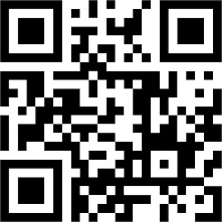
mValet PARKING
mValet PARKING
mValet PARKING
INFO
CARS
Quick Request
QUICK REQUEST
RATE US
GENERATE
QR CODE
RETRIEVE CAR
Ticket No: 19754
Date: 22 Mar 2015
7:21:44
CARS: QUICK REQUEST
FEEDBACK
CONTACT US
Valet Possession
Validated
Previous
Retrieve Car

Slide 15
mValet PARKING
mValet PARKING
CARS: QUICK REQUEST
Ticket No: 19754
Date: 22 Mar 2015
7:21:44
Ticket No: 19754
Date: 22 Mar 2015
7:21:44
Valet Possession
Validated
Please reach Valet station with in
5 minutes
Retrieve Car

Slide 16

mValet PARKING
mValet PARKING
INFO
CARS
Rate us
QUICK REQUEST
RATE US
RATE US
FEEDBACK
CONTACT US
Previous
Save

Slide 17
mValet PARKING
mValet PARKING
Feedback
INFO
CARS
Subject
Message
QUICK REQUEST
RATE US
Previous
Save
FEEDBACK
FEEDBACK
CONTACT US

Slide 18
mValet PARKING
mValet PARKING
INFO
CARS
Contact Us
Oscar Services LLC
P.O.Box – 22887
Dubai, United Arab Emirates
TEL : + 971 - 4 - 23 88 799
FAX : + 971 - 4 - 23 88 810
Email: Info@oscarservices.ae
QUICK REQUEST
RATE US
CONTACT US
FEEDBACK
CONTACT US
Previous

Slide 19

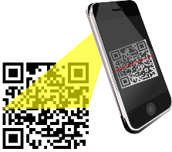
mValet PARKING
CVA
LOGIN
Login Here
Username
Password
Login
1
2
3
CVA
Download the App and the QR Code scanner in the device

Slide 20
mValet PARKING
mValet PARKING
CHECK-IN
CHECK-OUT
Looking up QR code…
LOGOUT
EXIT APP
CHECK IN

Slide 21


mValet PARKING
mValet PARKING
mValet PARKING
Parking No.
Guest Type
P01
Guest Type
Images
Room Number
Images
Room Number
Ticket #
1234
Car Model
Toyota
Notes
Notes
Car Color
White
Emirate
DXB
Code
A
Previous
Next
Previous
Next
CHECK IN
Plate No
843064
Name
John
Contact #
052714063
Previous
Next

Slide 22
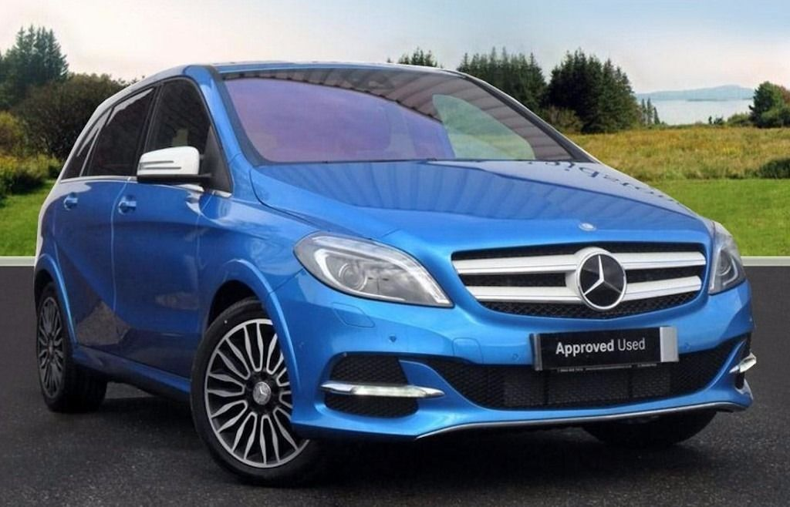
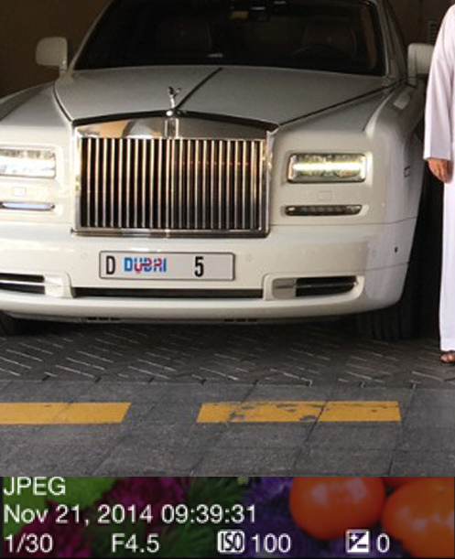
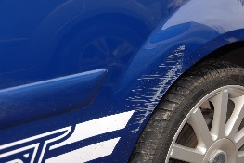
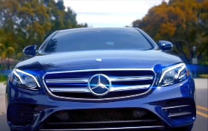
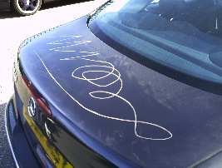
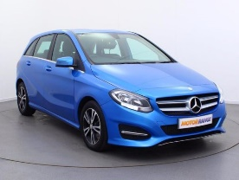

mValet PARKING
mValet PARKING
mValet PARKING
P01
VIP
Photo Library
Images
Room Number
Notes
Previous
Skip
CHECK IN
Upload

Slide 23
mValet PARKING
mValet PARKING
mValet PARKING
Looking up QR code…
CHECK IN: QR Code SCANNING OF PARKING LOT
Parking No.
P01
Parking No.
P01
Scanned No.
Scanned No.
P01
SCAN PARKING QR CODE
Previous
Save
Previous
Next
Previous
Save

Slide 24
mValet PARKING
mValet PARKING
mValet PARKING
mValet PARKING
Ticket #
1234
Fees
Parking No.
P01
Cashier Name
CHECK-IN
CHECK-OUT
Car Model
Toyota
Car Color
White
Notes
Emirate
DXB
LOGOUT
EXIT APP
Code
A
Plate No
843064
Previous
Save
CHECK OUT
Contact #
0527140637
Name
John
Validation
YES
NO
Previous
Save

Slide 25

mValet PARKING
mValet PARKING
Login Here
Restaurant
Username
Password
VALIDATION
LOGOUT
RESTUARANTS AND MALLS
Login
Scan the QR Code provided by the guests for Validation

Slide 26

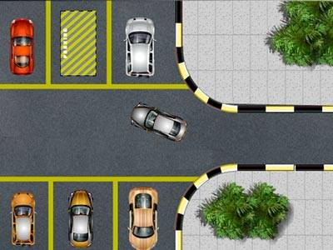
2
BENEFITS: IMPROVE PARKING LOT MANAGEMENT
mValet PARKING
Find the parking lot using app (CVA independent on parking lot allotment) & get updated in the system
Find Parking Space
Search Parking Space
GO
1
3
Valet Station
Park the vehicle in the Reserved lot

Slide 27

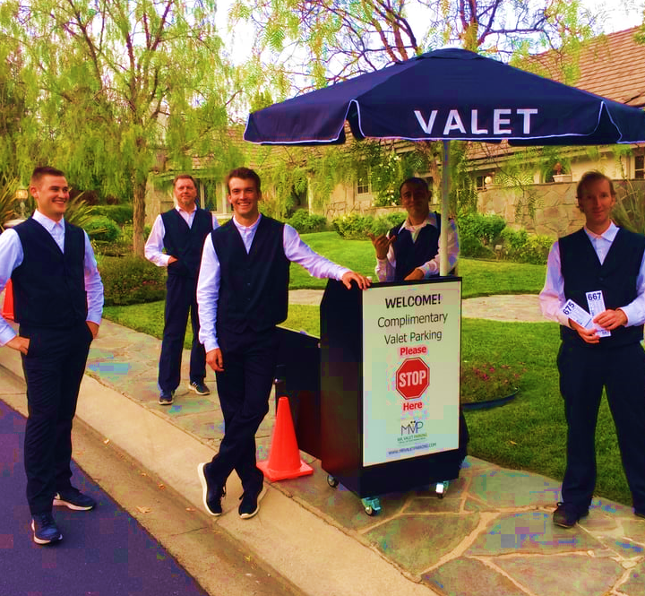

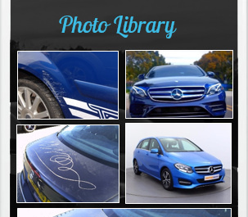

Images of the vehicle can be taken incase of any damages & get saved in the system
BENEFITS: IMPROVE RISK MANAGEMENT
Images of the vehicle from the system can be shown to the Customer in case of any argument
Arguments can arise on damage / Scratches when the car is retuned to the customer

Slide 28
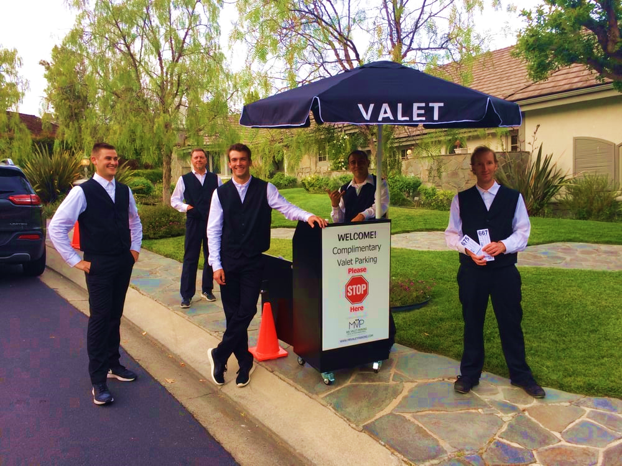
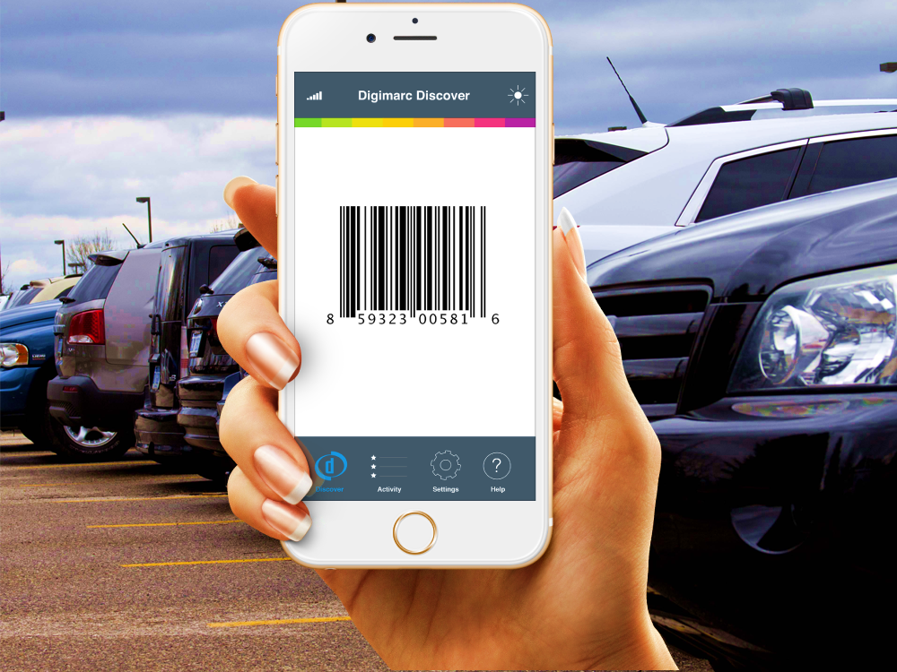

BENEFITS: IMPROVE RISK MANAGEMENT
A
B
Receive Car at Valet Station
QR Code get scanned in the parking lot, hence reconfirms the parking lot number
Handover the right vehicle to the owner
C

Slide 29

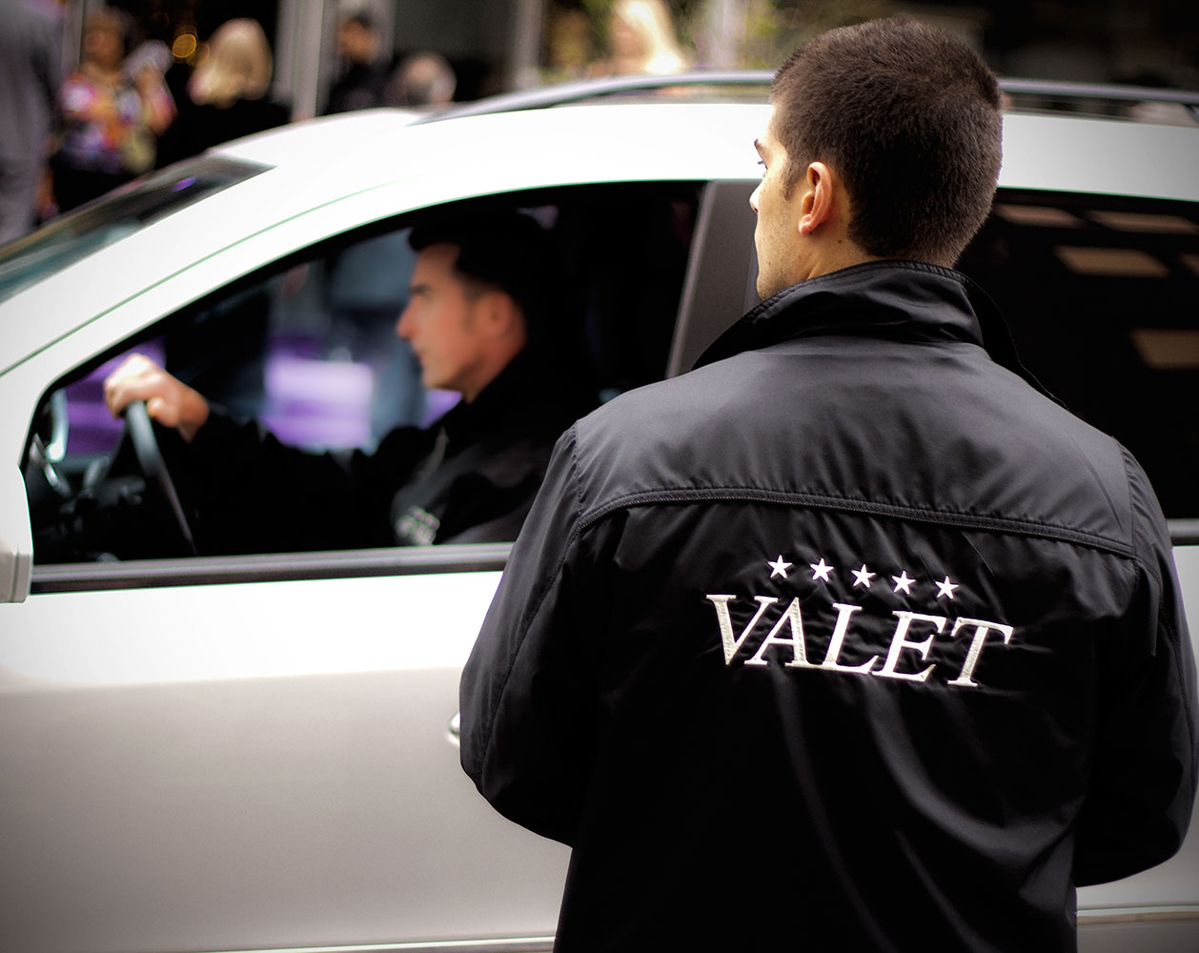
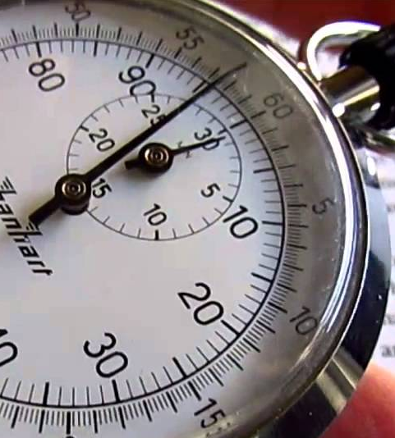
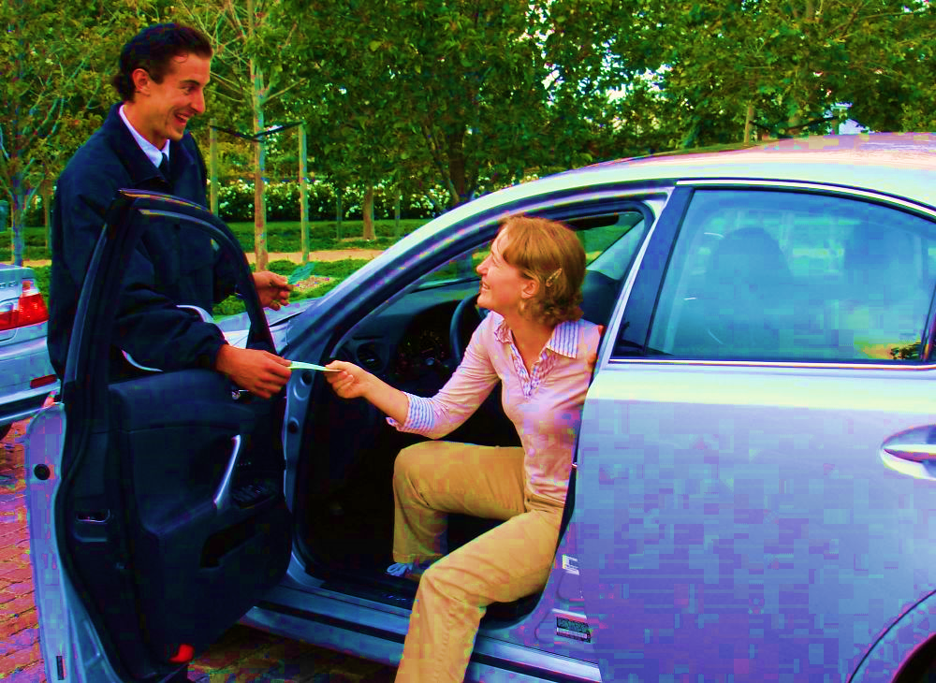
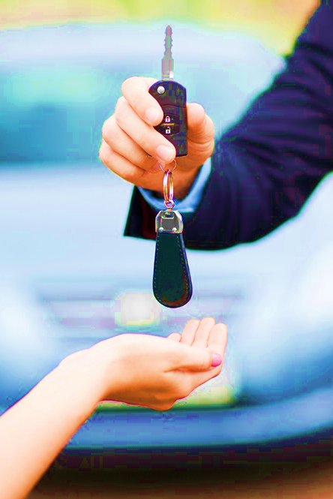
BENEFITS: NUMBER OF EMPLOYEES CAN BE MINIMIZED
Get the vehicle, guests information by scanning the QR Code. Finding out free parking lot is also much easier & independent
Time Saving
Each CVA will be able to manage more guests on a daily basis
A
B
C

Slide 30

[
[
Q A
nd

Slide 31

Thank You
www.verbat.com
© 1999-2017. All Rights Reserved. Verbanet Technologies LLC.

Slide 32
Solution with the following details
Oscar services (CVA user) enter car details of the customer in their mobile device during check-in
Oscar services (CVA user) provide plastic cards with QR code to customer and retain one card with Oscar services
Oscar services (CVA user) park the car in the parking location and enter parking lot number
Restaurants can use validator to validate the card with the customer
Our current web application will get a notification/message of validation from the restaurant
Customer scan the mobile QR code and it will get redirect to a page where they have option to retrieve car.
Oscar services (CVA user) retrieve the car and handover to customer if the card is validated by the restaurant.
If the card is not validated by the restaurant, they have to pay fee as defined in the PPT

